Slide 1

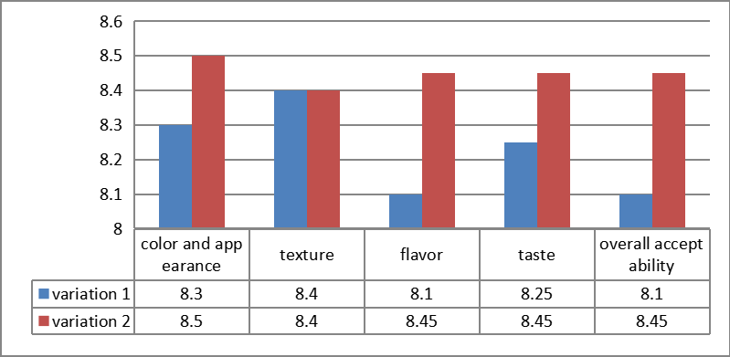
DEVELOPMENT AND SENSORY EVALUATION OF COLOURED MILLET PIZZA BASE
ABSTRACT:
The high calorie and low fibre content of pizza makes it unsuitable for consumption by people suffering from diabetes and cardio vascular disease, therefore incorporation of millet flour in the pizza base may enhance its nutritional quality and makes it suitable for the people with above said diseases. Though some work has been done on incorporation of finger and barnyard millet flour in baked products like bread, buns, cookies etc. However very little information on formulation of millet incorporated pizza base is available. Keywords: millet, sensory characteristics, pizza.
INTRODUCTION
The history of pizza begins in antiquity, when various ancient cultures produced basic flatbreads with several toppings.A precursor of pizza was probably the focaccia, a flatbread known to the Romans as panis focacius, to which toppings were then added. Modern pizza evolved from similar flatbread dishes in Naples, Italy, in the 18th or early 19th century
OBJECTIVE
Nutritive Value
To formulate three types of coloured millet pizza base.
To evaluate the sensory characteristics of coloured millet pizza base.
To determine the nutrient content of the developed coloured millet pizza base.
VARIATION 1
Energy 321.11 kcal
Carbohydrate 56.42 g
Fat 4.01 g
Protein 7.10 g
Dietary Fibre 9.6 g
VARIATION 2
Energy 270.21kcal
Carbohydrate 60.1 g
Fat 4.1 g
Protein 5.3 g
Dietary Fibre 9.32 g
METHODOLGY
seive the wheat flour and bajra millet
mix it with the beetroot juice
make a dough
proofing
heating
Cost Calculation
Cost Prices
Variation 1 – RS 20
Variation 2 – RS 18
V1 V2
SENSORY EVALUATION
sensory scores for development of coloured millet pizza base
S.NO | CRITERIA | VARIATION 1 | VARIATIION 2 | S.NO
1 | COLOR AND APPEARANCE | 8 | 8 | 1
2 | TEXTURE | 7 | 5 | 2
3 | FLAVOR | 4 | 6 | 3
4 | TASTE | 9 | 9 | 4
5 | OVERALL ACCEPTABILITY | 8 | 8 | 5
CONCLUSION
From the investigation, it is evident that millets can be effectively used in the formulation of coloured millet pizza base by properly blending it in appropriate proportions with other ingredients like beetroot,corn,wheat flour,bajra millet flour,yeast,oil. The data obtained from Organoleptic evaluation showed that the fried millet prepared from ready-to-cook coloured millet pizza base sample in the test sample v2 was found to be liked very much in terms of colour & appearance, flavor , taste, texture and overall acceptability. Thus, this study has shown a way, for effective utilization of readily available instant millet mix. On the basis of chemical analysis the ready-to-use coloured millet pizza base test sample v2 showed maximum value for energy, carbohydrates, protein, dietary fibre, vitamin and minerals but lower value for fat. It is concluded that the prepared coloured millet pizza base is nutritious and cost effective.

